Slide 1

CAR Rental Application
Created by Roberto Benitez & Kavya Katariya

Slide 2
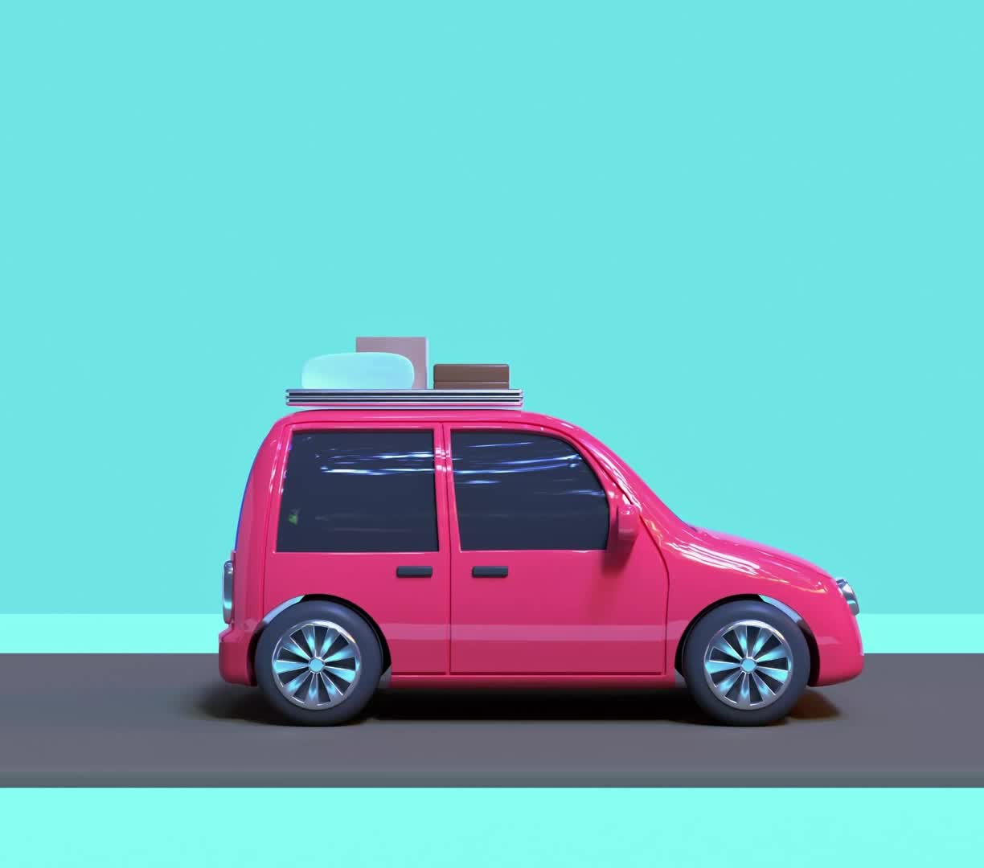
Welcome to our presentation on our car rental web application! In this presentation, we will walk you through the key features and functionalities of our application, which is built using the React framework.

Slide 3

Our car rental web application is designed to provide users with a seamless and user-friendly experience for renting cars online. It offers a wide range of features to both customers and administrators, making it a comprehensive solution for car rental businesses.

Slide 4
Key Features
User Registration and Authentication: Users can create accounts and log in securely to access the application.﻿
Car Listings: Customers can browse through a vast inventory of available cars, view details, and compare options.
Search and Filters: Users can search for specific car models or use filters to refine their search based on criteria like price, location, and car type.
Booking and Reservations: Customers can book their desired car by selecting dates, specifying pickup and drop-off locations, and making online payments.

Slide 5

Technology Stack
React: We have chosen React as our front-end framework due to its flexibility, component-based architecture, and efficient rendering.
Bootstrap: We have employed Bootstrap for responsive and mobile-friendly UI components, ensuring a consistent and visually appealing design across devices.

Slide 6
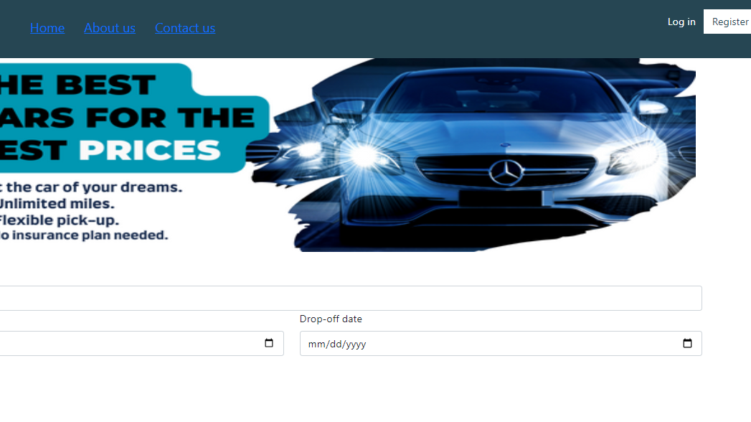

Slide 7
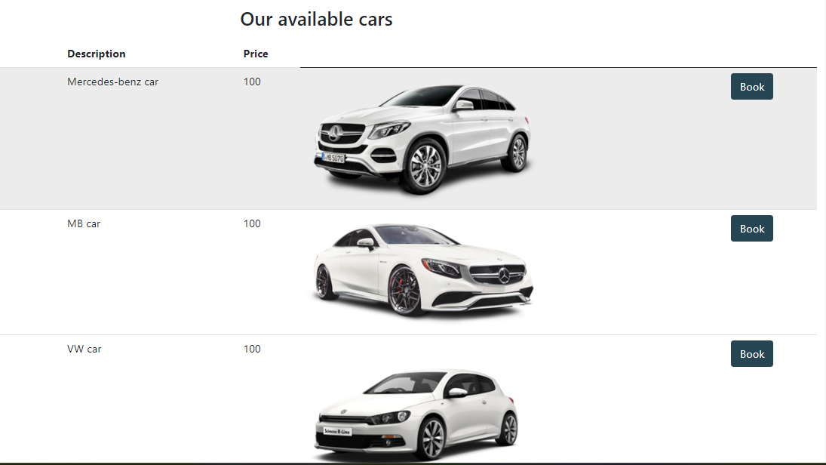

Slide 8
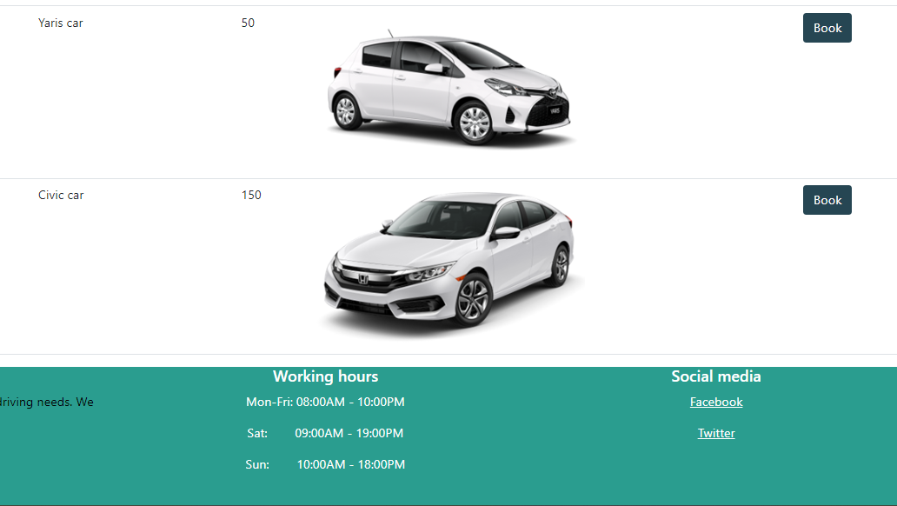

Slide 9
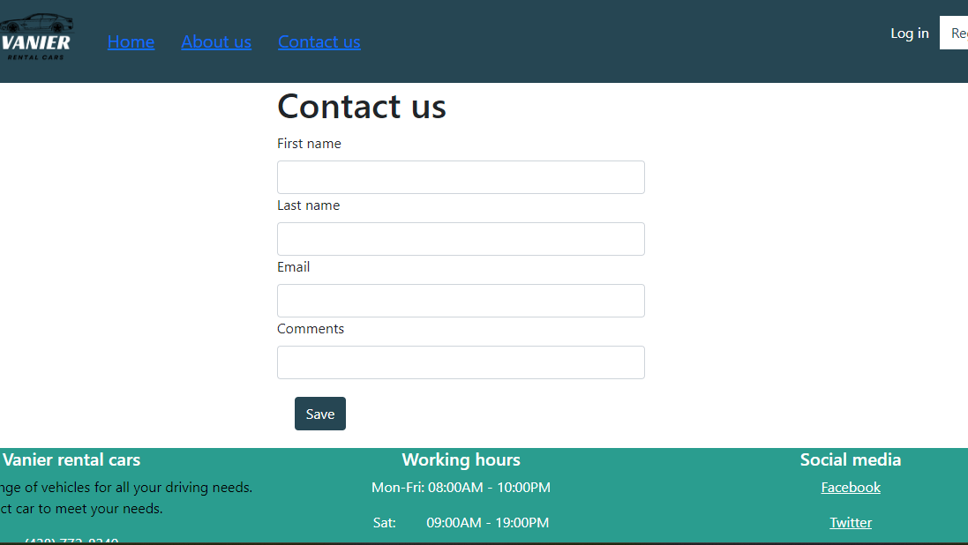

Slide 10
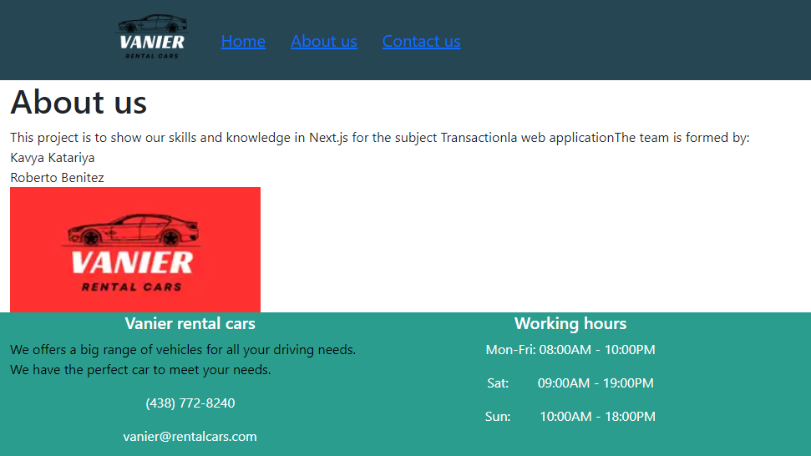

Slide 11

About the experience of learning Transactional Web Subject
React has been quite challenging, but we appreciate your guidance and support throughout the learning process. Your expertise and clear explanations have helped us to navigate the complexities of React and understand its concepts better.
Although React can be difficult at times, we believe that with your assistance, we have made significant progress. Your patience and willingness to address our questions and concerns have made a notable difference in my learning experience.
The resources you shared, including tutorials and documentation, have been immensely helpful in deepening our understanding of React.

Slide 12

Conclusion
In conclusion, our car rental web application built with React offers a comprehensive solution for car rental businesses and a user-friendly experience for customers. With its key features, robust architecture, and emphasis on performance, our application is poised to revolutionize the car rental industry.

Slide 13

Thank you. Please ask your Questions.

